Slide 1
Glow on the Leaderboard, Dough in the Bank
How underwriting and follow-up seal the deal

Slide 2
Underwriting & Follow-up
Pre-Sale Underwriting
Appointment Underwriting
Presenting Proper Options
Post Sale
Notes:
Proper underwriting is crucial as that is the roots for building client relationships –
This is your trust and credibility – you are demonstrating your expertise and commitment to understanding your clients needs so you can build a personalized solution – which is essential for long term relationships
By understanding and addressing the risks up front you can better offer solutions that enhance the clients confidence in you.

Slide 3
Pre-Sale
Proper Underwriting
CQF
Navigator
GuideFather – Excellent Tool
Medical Conditions
Build Charts
Gameplanning
Mentor
Group Scheduled Calls
Agent Guides (Guidefather)
Carriers
Risk Assessments
Applications if available
Notes:
All tools are there to help in underwriting but they are not 100% -
GAMEPLANNING
Group Scheduled Calls – Mathews has a set M/W/F 8:30-9:30 the last portion of the Optimize calls
CARRIER RISK ASSESSMENTS
Abnormal health conditions, multiple conditions (call them or chat with them)

Slide 4
Pre-Sale
Underwriting in the Appointment
Review Health Information provided
Navigator
Additional Information not asked on initial booking (phone/text)
Notes:
During the appointment you want to get further clarification on health – you already did a high flyover when you booked the appointment but now it is time to make sure you know everything – you already set this up in your role and purpose – REALLY like how Joel Kimzey reintroduces this piece
George, Janet. As I mentioned in the beginning, mortgage protection can typically be done without a medical exam but since its coverage we have to qualify for based on our health, an insurance company needs to check us out. Afte we give them permission to do so, they base their decision primarily on 2 sources of information they access: the MIB and the prescription database. If we’ve ever been to the hospital, had any kind of surgery or any diagnosis, they can see it. Any medication, and I mean ANY medication we’ve been prescribed, they can see it. So its vitally important for any field underwriter to know these things so he/she can find the carrier that will #1 approve the howeowner #2 Give the homeowner the best rate So please be very candid with me. Run through Navigator questions
Then ask what medications if any would they find that have been prescribed to you in the last 2 years regardless if you never opened the bottle or picked it up at the pharmacy * A lot of medications are prescribed for different reasons – always ask why they are taking it. Diagnosed condition. NOTATE EVERYTHING DOWN – you will need this later on. TERESA’ s Version Life insurance is not something that you can just buy – you have to qualify and as a field underwriter I am only as good as the information that you share with me. Once the application is submitted, that is your permission for the carrier to do a FULL medical underwriting. access your medical records to see everything – they will see if you doctor prescribed a medication in charts – whether you are taking it or not taking it. It is always best to give the data to them ahead of time. Risk goes up if they feel like you are hiding something. There are also a lot of dual use medications so we want to tell them what and WHY
USE NAVIGATOR

Slide 5
Sale
Presenting Options
Listen to your Client
Select the right product
Fit the budget
Client Chooses THEIR best fit – you write the application
TIE down the process / Next Steps
Underwrting process – timeframe, what can happen
Drafting of 1st premium
Notes:
Right product / Right price
Listen to them to understand - especially finances and budget – not about what you are trying to sell.
Fitting the Clients budget if vitally important – again in the Role in Purpose you shared with them WHILE BUILDING TRUST that not everyone needs this, most people actually need less coverage than they think they do. I always tell them that the only type of insurance that is good is the type that they have when they need it. If you put the client into something that does not fit the budget then they will end up canceling the policy and you could end up with a “charge back”. No one likes charge backs and more importantly – if client cancels a policy then their family is not protected and you have not done your job by helping them to solve their problem. Present 3 options, they pick but RE-ASK if it is comfortable
APPLICATION WRITTEN I will usually transition into the application by asking them to grab their drivers license or ID while I log into the carrier. I let them know that I am sending them a link to the application so they can go through it with me (if not on ZOOM) – using CrankWheel. When we get to banking information – I remind them that the carrier is going to draft the premium when the policy is approved and that is when it will go in force. Is your draft coming out of a checking or saving account? Which bank do you use. – I ask this because I want them to know it will DRAFT immediately upon approval – I do not every ASK them when they want their policy to draft but if there is a problem with immediately I will hear it right here.
After Application is submitted I tell them what will happen next
“issued as applied for.” 2. Very common for them to come back with an additional question 3. Sometimes it can be declined. I am here with you every step of the way. 2. I am going to send you a copy of the application we submitted 3. I am going to text you my personal cell phone so you and (NAME of beneficiary) have my contact information when you need it.
Some carriers give an immediate decision – but if they don’t – then I explain next steps and when they can expect contact from me. If you promise – follow-up. Upon approval – the carrier will draft your 1st premium and your policy will be placed. You elected paper delivery so that usually takes 10-14 business days from approval – lets put something on the calendar now so we can do that policy review……We will go through everything on your policy together.

Slide 6
Post-Sale
Maximum Profitability
Tracking and Placement
Counting what Counts – simple (Activate Step 7)
White board (Scott Forehand)
OPT - detailed
Carrier Follow-up
Additional Information
Approved – draft
Declined
Client Follow-up upon Approval
Call and Congratulation them.
Scheduled Policy Review (schedule at time of sale)
Thank You Card
Policy Review - Annually
Notes:
Carrier follow-up – This is important to manage in your schedule – there is a right time and wrong time to try to reach a carrier, – It is best to schedule 30 minutes everyday to your pending business. 1st thing in the morning is better. Line is shorter – 30 mins. Be kind to the underwriters, ask if there is anything they need from you to help move things along – you will get to know the underwriters with the carriers
Each carriers website is a little different – Learn the carriers website.
If not issued immediately it is best to call the carrier – GET THE NAME OF THE PERSON
Additional Information – forms, how to process those, what is needed, how they will accept the data – wet signature, docusign etc….
Decline – either they were not truthful with you or something is wrong with the data – it is your job to become a detective and help figure it out so you can counsel with your mentor on what do do next.
Give you clients updates
APPROVED – it isn’t about when you get paid, it is about when the carrier received payment from the insured. All carriers are a little different. You want to make sure you know the policy issue paid date.
CLIENT FOLLOW-UP UPON APPROVAL
Congratulate them, see if they have any questions that might have come up during the approval process, reiterate they can contact you with any questions (I send my clients my CELL phone contact card when I write the application)
Policy Delivery – meet back with the client/preferably on zoom, let them see your face,
Go back through what the policy does and how it is going to provide from them
Shows client how you are going to take care of their family when they are not here – BUILDS trust
DELIVERY RECEIPTS
Would you mind helping me with something – Referrals, resets & recruits
Referrals: I loved helping you get this in place for your family – I was just wondering if there is anyone you know that does not have this plan in place, I would love to be able to help them
Resets: you already had a financial conversation during your appointment, you should know if they have debts, retirements etc….FIF reset on HQ
Recruits – loved helping you and your family and excited to help referrals. We are looking for more people to come and help us, do you know anyone that is looking for part-time or fulltime that might be interested in earning some extra income doing what I have just done for you?

Slide 7
Tracking
Starts when you write the Application
________ | Application Submitted
________ | Application Uploaded into OPT
________ | Carrier Received Application
________ | Underwriting Interaction
________ | Underwriting Requirements Completed
________ | Confirmation of Initial draft/Issue date
________ | Client notified of pending issue/draft
________ | Confirmation from carrier of issued-paid
________ | Policy delivery / Including Delivery Receipts if needed
________ | Policy delivery receipts submitted to carrier
________ | Policy delivery receipt received by carrier

Slide 8
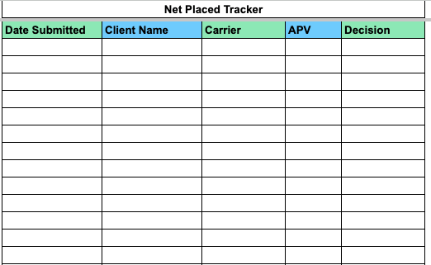
Examples – Counting What Counts

Slide 9
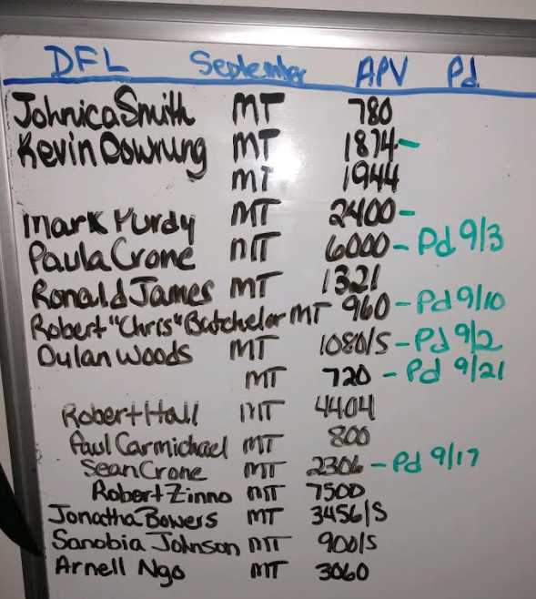
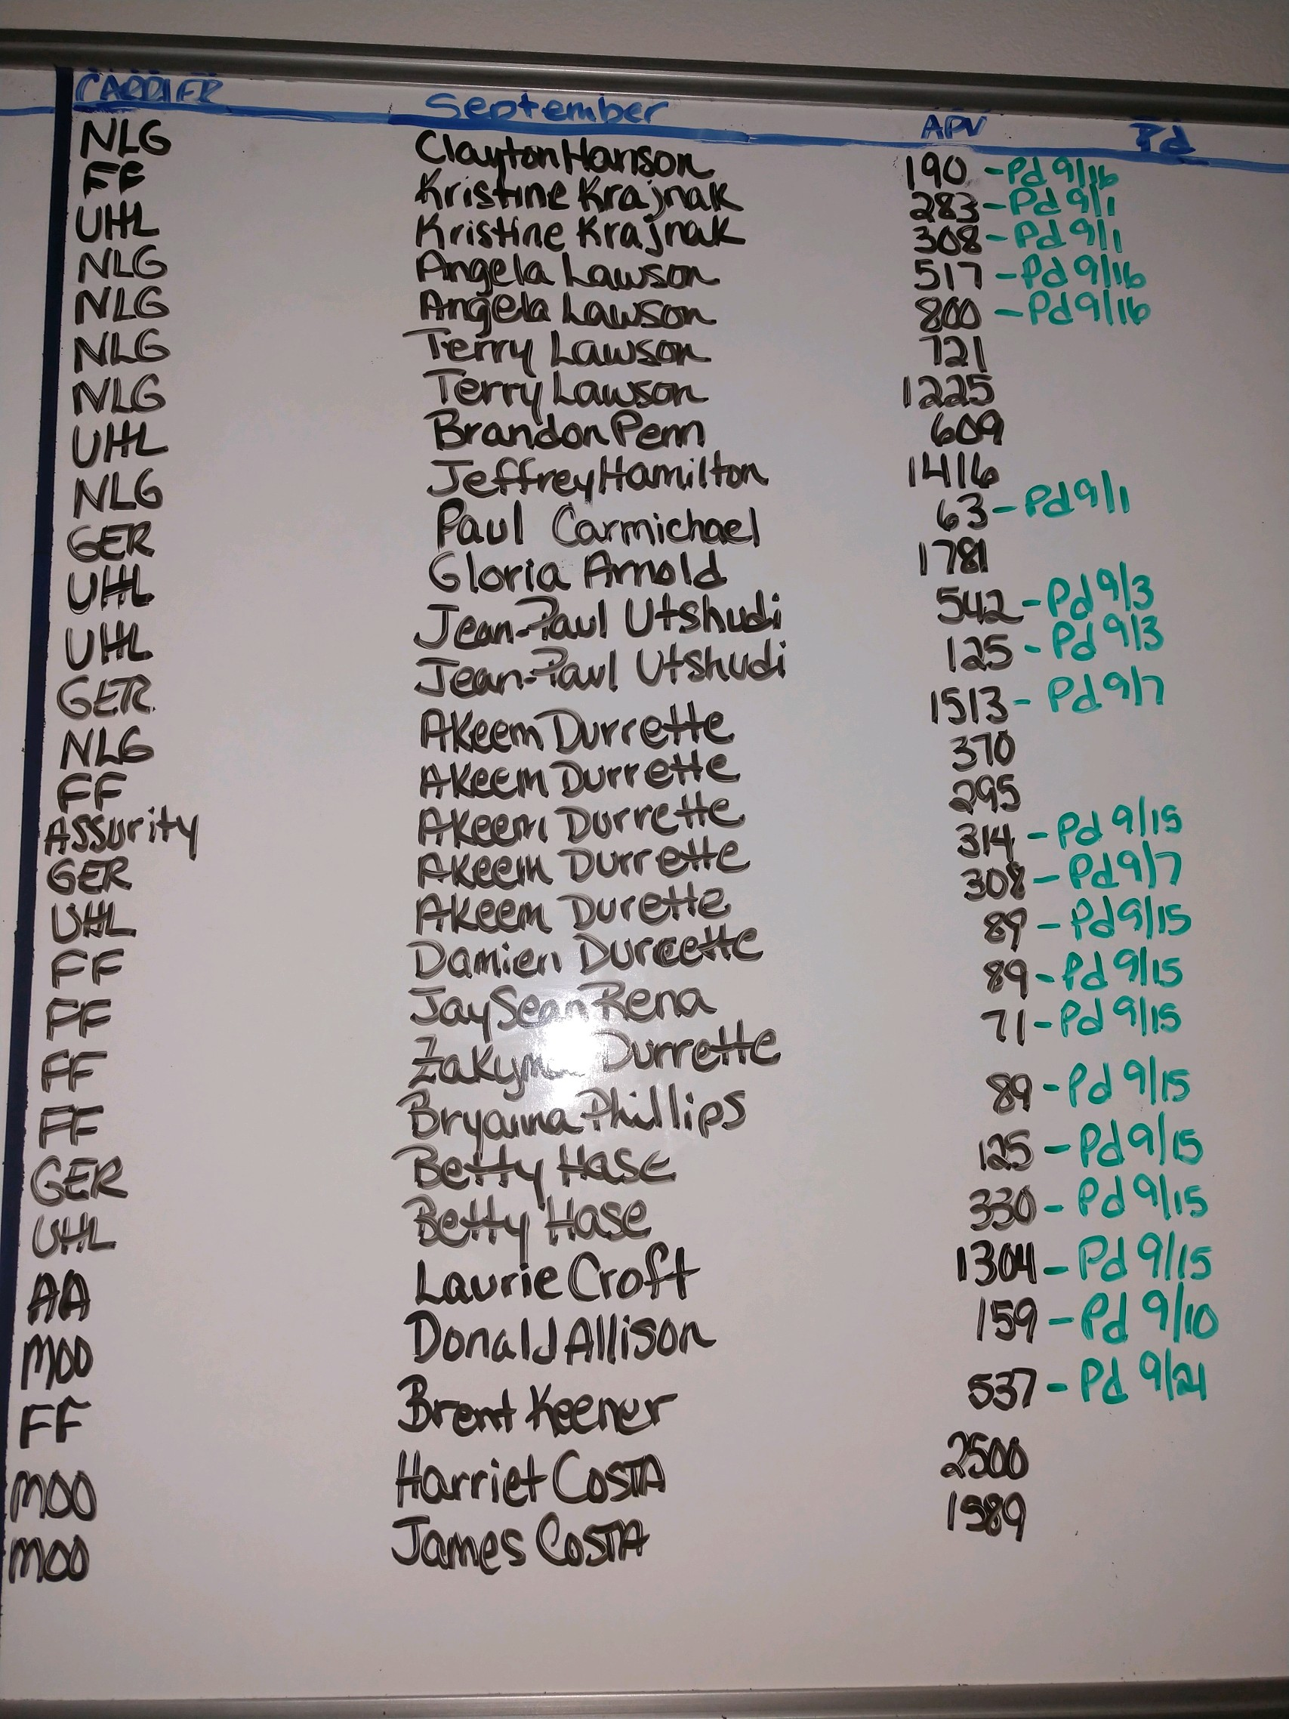
Examples – White Board

Slide 10
Tracking
Starts when you write the Application
________ | Application Submitted
________ | Application Uploaded into OPT
________ | Carrier Received Application
________ | Underwriting Interaction
________ | Underwriting Requirements Completed
________ | Confirmation of Initial draft/Issue date
________ | Client notified of pending issue/draft
________ | Confirmation from carrier of issued-paid
________ | Policy delivery / Including Delivery Receipts if needed
________ | Policy delivery receipts submitted to carrier
________ | Policy delivery receipt received by carrier

